Slide 1

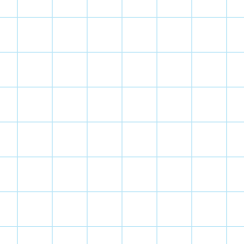
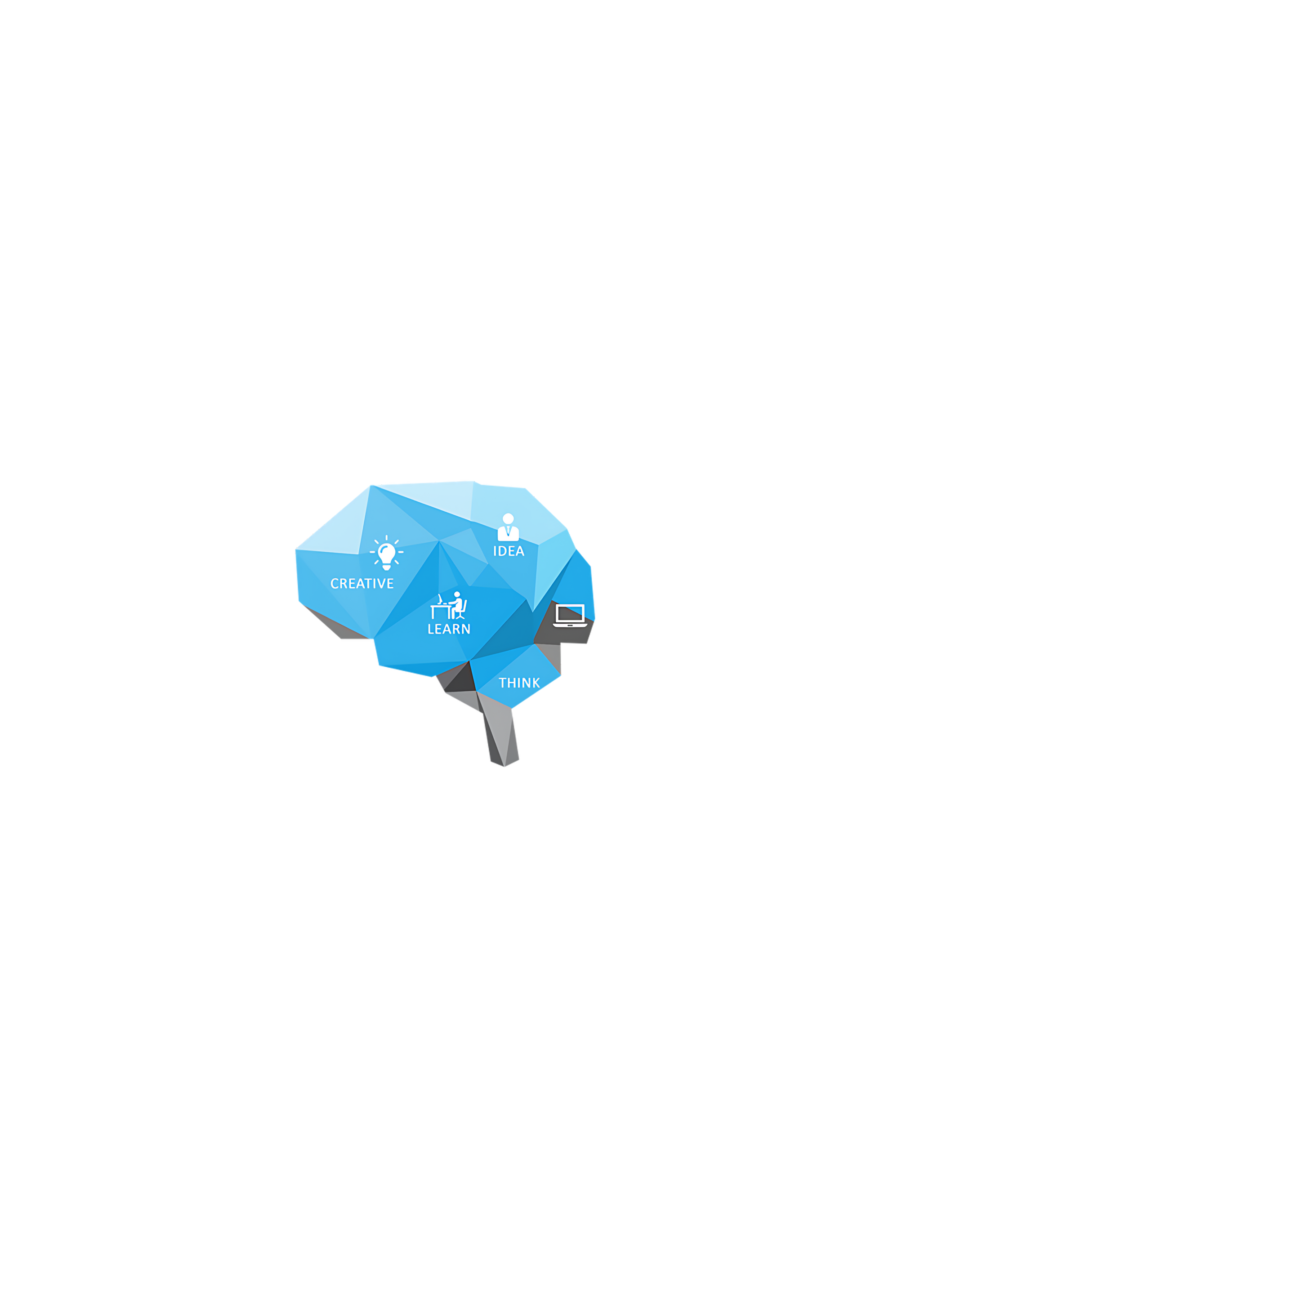

lv zero
Adhocs
session 4
prepared by : Hamed Mohamed
ICPC
MANSOURA

Slide 2





Who am i
1
CCSED LEVEL 200
2
Technical Member and problem setter In ICPC Mansoura
3
Embedded Supervisor, CAT Reloaded
intro
4
Participated in Ecpc Qualifications and ranked 7 out of 227
RocketLeague Champion

Slide 3
lv zero
Adhocs
session 4
prepared by : Eyad Abd El-Mohsen
ICPC
MANSOURA

Slide 4



Who am i
CCSED LEVEL 200
Technical Member, ICPC Mansoura
BackEnd Member, CAT Reloaded
intro
Tottenham fan , pingpong
Diamond Valorant player

Slide 5
intro

Slide 6
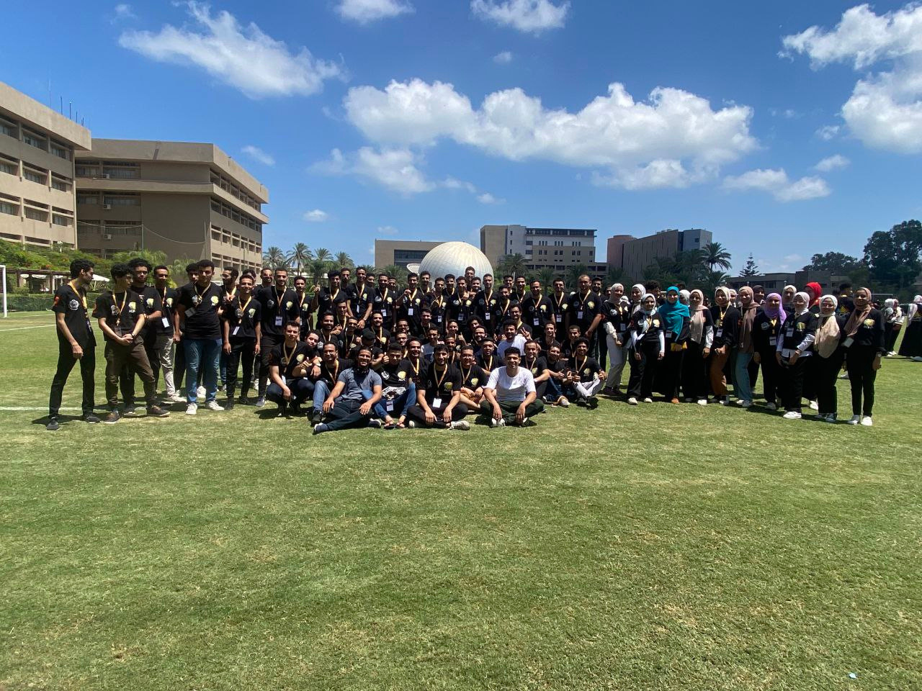

ECPC
?

Slide 7

lv zero
1
Frequency Array
TODAY'S AGENDA
2
Prefix Sum
3
Partial Sum
4
2D Prefix Sum

Slide 8


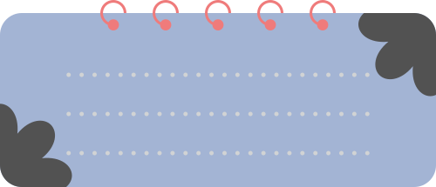

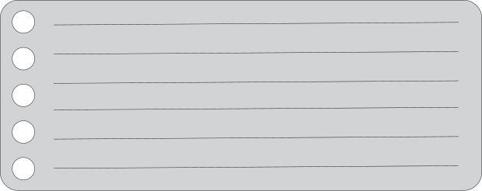



Array of Numbers
Array of Characters
Array of Characters
String of Digits
(String)
(String)
Freq[s[i] - 97]++;
Freq[s[i] - ‘a’]++;
Freq[arr[i]]++;
Freq[s[i] - ‘0’]++;
Freq[s[i] - 65]++;
Freq[s[i] - ‘A’]++;

Slide 9

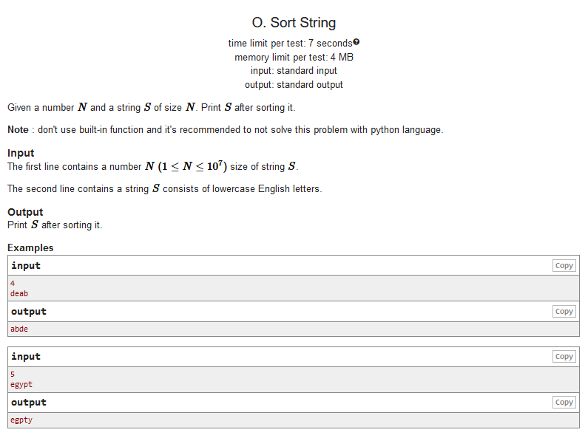
Statement
PROBLEM
LINK

Slide 10

Challenge!
Given an array of size N, You are asked Q queries In Each query : you are given integer K and you are asked to print the sum of the elements of the array from the "1st" element to the "Kth" element.

Slide 11


Complexity &
pre-processing

Slide 12

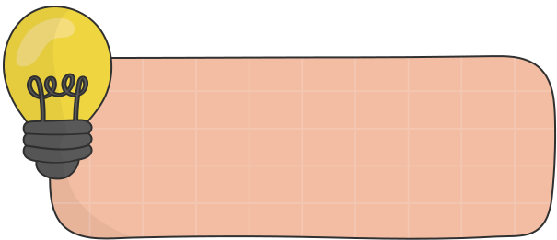



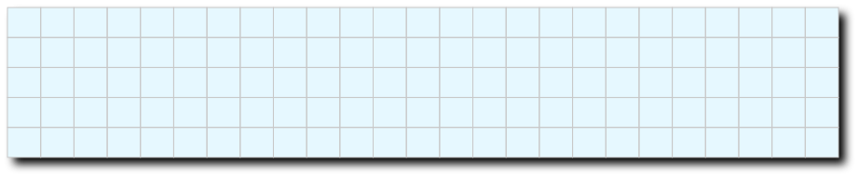
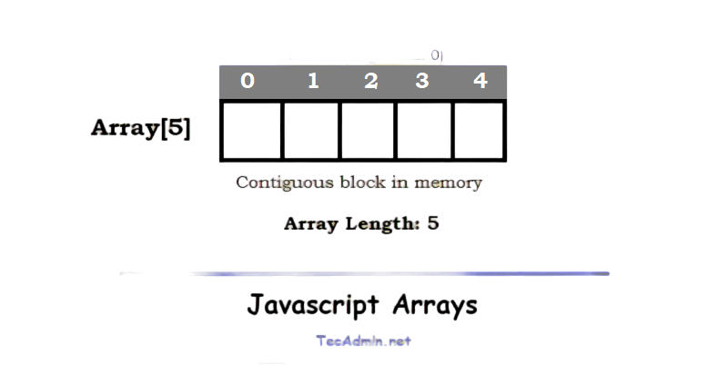
Each element in the prefix is the sum from the start to the element
Prefix Sum
1 2 3 4 5
5
5
2
4
-1
3
Array
Prefix

Slide 13
Each element in the prefix is the sum from the start to the element
Prefix Sum
1 2 3 4 5
5
2
2
4
-1
3
Array
5
5
5
Prefix

Slide 14
Each element in the prefix is the sum from the start to the element
Prefix Sum
1 2 3 4 5
5
2
4
-1
3
Array
5
5
7
2
Prefix

Slide 15
Each element in the prefix is the sum from the start to the element
Prefix Sum
1 2 3 4 5
5
2
4
-1
3
Array
5
5
7
2
11
Prefix

Slide 16
Each element in the prefix is the sum from the start to the element
Prefix Sum
1 2 3 4 5
5
2
4
-1
3
Array
5
5
7
2
11
10
Prefix

Slide 17
Each element in the prefix is the sum from the start to the element
Prefix Sum
1 2 3 4 5
5
2
4
-1
3
Array
5
5
7
2
11
10
13
Prefix

Slide 18
coding time

Slide 19

GIVEN AN ARRAY YOU ARE ASKED SOME QUERIES...
in each query you are given L, R and you are asked to print sum of the elements of the array between L, R.
l = 3, r=5
1 2 3 4 5
5
2
4
-1
3
Ans = 4 -1 + 3 = 6

Slide 20


l = 3, r=5
1 2 3 4 5
5
5
2
2
4
4
-1
-1
3
3
Array

Slide 21
5
2
4
-1
3
Prefix [5] =
= 13
l = 3, r=5
1 2 3 4 5
5
5
2
2
4
-1
3
Array

Slide 22
5
5
2
2
4
4
4
-1
-1
-1
3
3
3
Prefix [5] =
= 13
5
2
5
2
Prefix [2] =
= 7
l = 3, r=5
1 2 3 4 5
5
2
4
-1
3
Array

Slide 23
5
2
4
-1
3
Prefix [5] =
= 13
-
5
2
Prefix [2] =
= 7
=
5
5
2
2
4
4
-1
-1
3
3
= 6
l = 3, r=5
1 2 3 4 5
5
2
4
-1
3
Array

Slide 24
coding time

Slide 25
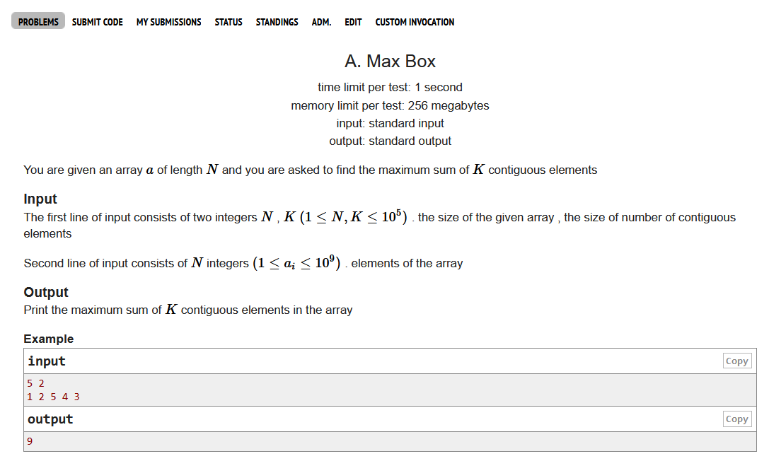

problem
PROBLEM
LINK
SOLUTION

Slide 26
PREFIX PRODUCT
Prefix[i] *= prefix[i - 1];
ans = prefix[R]/prefix[L - 1];
PREFIX MAX
PREFIX
pre[i] = max(pre[i - 1), arr[i])
PREFIX MIN
is not only sum !
pre[i] = min(pre[i - 1] , arr[i]) ;

Slide 27

Break time

Slide 28

Challenge!
GIVEN AN ARRAY OF SIZE N, YOU ARE ASKED Q QUERIESIN EACH QUERY , YOU ARE GIVEN :
Integer V and you are asked to add V to each element in the array print the sum of each element in the array after all updates

Slide 29
Challenge!
Make it
harder
GIVEN AN ARRAY OF SIZE N, YOU ARE ASKED Q QUERIESIN EACH QUERY , YOU ARE GIVEN :
Two integers , value V and postion K and you are asked to add the value V from index K to the end of the array

Slide 30
Challenge!
Make it
hardeeeeeeeer
Yamete kudasai
GIVEN AN ARRAY OF SIZE N, YOU ARE ASKED Q QUERIESIN EACH QUERY , YOU ARE GIVEN :
Three integers, positions L , R and value V and you are asked to add the value V from position L to position R in the array .

Slide 31
+ Partial sum -

Slide 32






Partial sum steps
1
2
3
4
5
STEP
STEP
STEP
STEP
STEP
MAKE AN ARRAY FOR UPDATES
ADD THE VALUE TO UPDATES[L]
ADD THE VALUE WITH OPPOSITE POLARITY TO UPDATES[R + 1]
PREFIX SUM ON THE UPATES ARRAY
ADD UPDATES TO THE ORIGINAL ARRAY
int update[N] ;
update[l] += val
updates[r + 1] -= val
updates[i] += updates[i - 1]
arr[i] += updates[i]

Slide 33
coding time

Slide 34
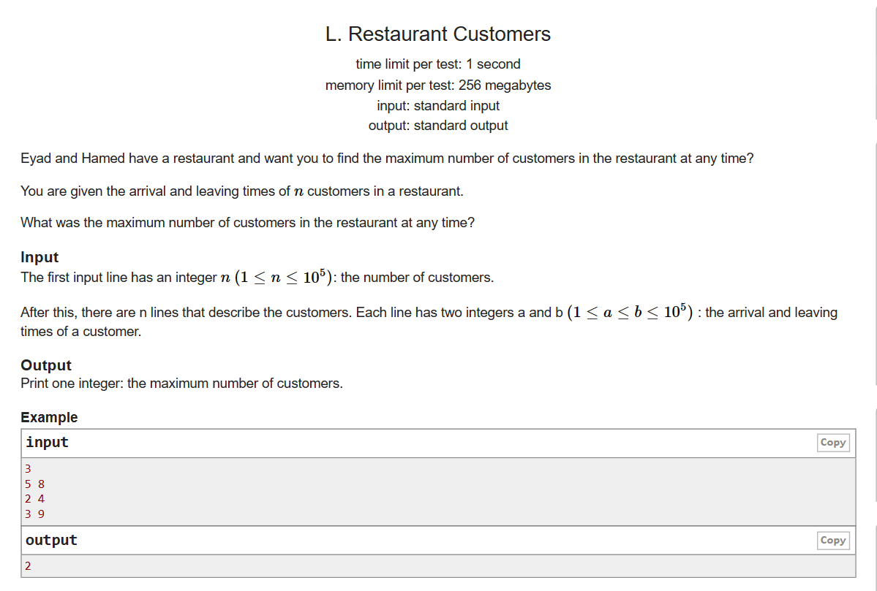
problem
PROBLEM
LINK
SOLUTION

Slide 35
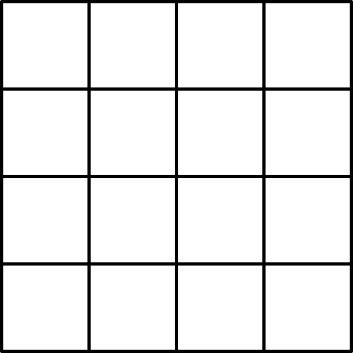

Challenge!
6
7
8
9
3
Having a 2d array and you are asked to find sum of elements in the box :
5
4
2
4
7
8
3
3
5
3
3
UP = 2 LEFT = 2
DOWN = 3 RIGHT = 4

Slide 36
2D prefix sum

Slide 37


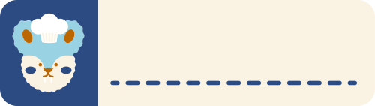



Recap 2D prefix steps
STEP 1
STEP 2
STEP 3
STEP 4
Make an 2D array for prefix
Prefix sum for each row
Prefix sum for each column
Calculate the answer
int pre[N][N];
pre[i][j] += pre[i][j - 1];
pre[i][j] += pre[i - 1][j];
Ans =
+ pre[D][R]
- pre[D][L - 1]
- pre[U - 1][R]
+ pre[U - 1][L - 1];

Slide 38
coding time

Slide 39
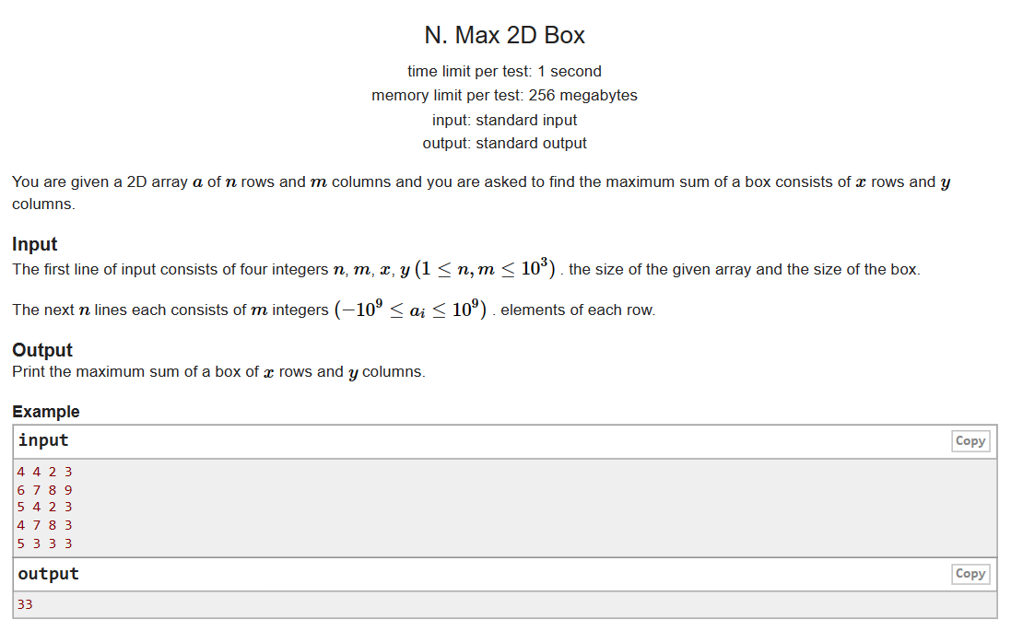
problem
PROBLEM
LINK
SOLUTION

Slide 40








الخلاصة في المصاصة
Frequency array
Prefix Sum
Partial Sum
2D Prefix Sum
upd[l] += val
upd[r + 1] -= val
ANS=
+ pre[D][R]
- pre[D][L - 1]
- pre[U - 1][R]
+ pre[U - 1][L - 1];
Freq[arr[i]]++;
Prfx[i] += prfx[i - 1]
upd[i] += upd[i - 1]

Slide 41
thank you

